Slide 1
EARCENT · SERVICE BLUEPRINT
The four services in detail
A shareable overview of the going-global scope
Earcent · Service blueprint
v1.0 · 2026

Slide 2
Service blueprint
2 / 9
Earcent · Service overview
Agenda
Single items or the full journey — you choose.
01
Digital foundation
02
Offshore company
One item only? Of course
How we work
Site / standalone store, internal systems, integrations.
Hong Kong, Singapore, US entities and more.
03
Export paperwork & customs
04
Overseas market, 0→1
A typical engagement
Before we start
Licences, documents, AEO broker co-ordination.
Market judgement, acquisition, English content.

Slide 3
Service blueprint
3 / 9
Earcent · Service overview
The four services, on one page
Any one can start alone, and any can compose into a full pipeline.
01
02
03
04
DIGITAL
OFFSHORE
EXPORT
MARKET
Digital foundation
Offshore company
Export paperwork & customs
Overseas market, 0→1
Site / standalone store, internal systems, integrations.
Hong Kong, Singapore, US entities and more.
Licences, documents, AEO broker co-ordination.
Market judgement, acquisition, English content.
Company site or standalone store
Licensed secretarial execution
Category control and licence map
ICP and channel judgement
Internal systems and data flow
Bank account co-ordination
Commercial invoice / packing / C/O
English content production
English copy and SEO baseline
Annual compliance and review
AEO broker co-ordination
Cold start and first customers
Payment and FX pathway wiring
Group structure design
Tax refund and FX settlement
Conversion and retention dashboards

Slide 4
Service blueprint
4 / 9
Earcent · Service overview
01
DIGITAL
Digital foundation
01
02
03
04
Pain
Our role
Deliverables
Single-item path
No standalone site, marketplace-only
Site / store setup and launch
Live site / store
Just the site
Scattered systems
Content and SEO baseline
Integration diagram and docs
Just one integration
No first-party data
System integration
English content and SEO baseline
Just English content
No payment / FX path
Payment / FX wiring
Payment / FX test report
Just payment / FX

Slide 5
Service blueprint
5 / 9
Earcent · Service overview
02
OFFSHORE
Offshore company
01
02
03
04
Pain
Our role
Deliverables
Single-item path
Where to incorporate
Licensed secretarial execution
Certificate / business registration
Just the site
Bank onboarding friction
Bank account documents
Bank account and KYC file
Just one integration
Structure and tax
Structure design
Group structure diagram
Just English content
Annual compliance
Compliance calendar
Compliance checklist
Just payment / FX

Slide 6
Service blueprint
6 / 9
Earcent · Service overview
03
EXPORT
Export paperwork & customs
01
02
03
04
Pain
Our role
Deliverables
Single-item path
Category control unclear
Licence and document map
Licence / filing pack
Just the site
Customs delay hits delivery
Broker co-ordination and review
Customs and clearance log
Just one integration
Tax refund and FX path
Tax refund and FX design
Refund and FX settlement
Just English content
AEO qualification gap
Risk and contingency
Review and risk notes
Just payment / FX

Slide 7
Service blueprint
7 / 9
Earcent · Service overview
04
MARKET
Overseas market, 0→1
01
02
03
04
Pain
Our role
Deliverables
Single-item path
Which market first
Market judgement
Market and channel map
Just the site
No English content system
English content system
English content and posts
Just one integration
Acquisition cost runaway
Cold start and first customers
First customers and metrics
Just English content
No conversion dashboards
Dashboards and review
Review and next quarter
Just payment / FX

Slide 8
Service blueprint
8 / 9
Earcent · Service overview
One item only? Of course
Start narrow, expand later.
01
Just a website
02
Just an offshore company
03
Just export customs
04
English site + payment path only
Digital foundation
Offshore company
Export paperwork & customs
Overseas market, 0→1
How we work
Transparent pricing
No package required
Local execution
Trustworthy data
Itemised and staged, no bundled surprises.
Begin with one item, expand or pause any time.
Licensed agents, brokers and banks do the work.
Categorised files, milestones on record.

Slide 9
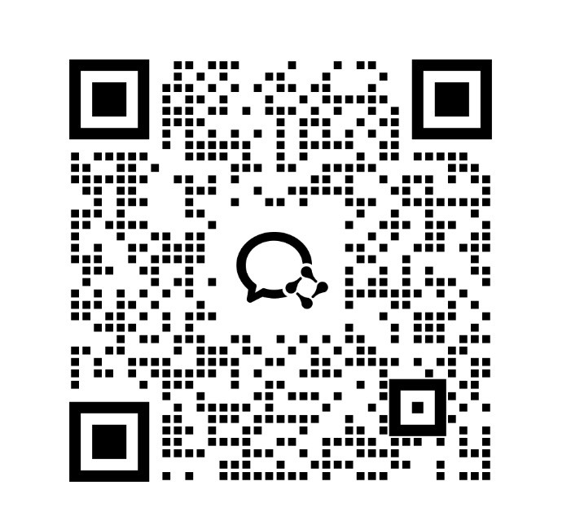
Before we start
Skim the deck, then book a 30-minute video call.
Use the project intake form to brief us
Forward this deck to your team
We reply within one business day
Book a consult →
or scan our WeChat QR on the right
Earcent · v1.0 · 2026

